Slide 1





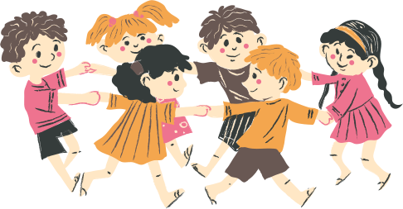

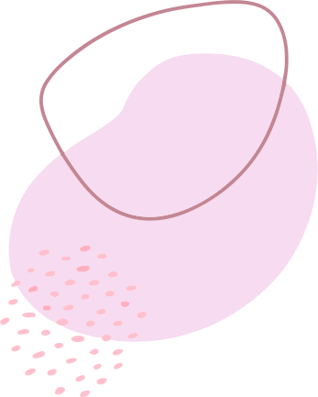
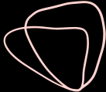
ATTACHMENT

Slide 2
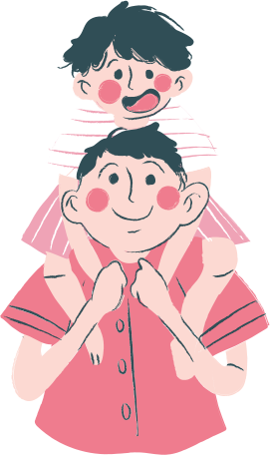


What does attachment do?
According to The Developing Mind
Infants uses an attachment figure's (parents, caregivers, therapists) state of mind to regulate.
"Infant attachment studies remind us of the crucial important of attuned nonverbal communication in all forms of human relationships "
What does this reminds you of?
How do you use this information in your work?
Notes:
Attachment is basically "attunement" - the book talked about how it aligns states of mind. So if you are calm, the child is calm.
For the nonverbal infant, communication is done without words. E.g. peekaboo, exaggerated facial expressions etc.

Slide 3


Slide 5


Secure Attachment
  Children distressed when parents were gone
  Children greets parents actively, usually initiating physical contact
  Children quickly soothed and return rapidly to play
  Parents were sensitive to the children's signals
  Parents were emotionally available, perceptive, and effective at meeting the children's needs

Slide 6
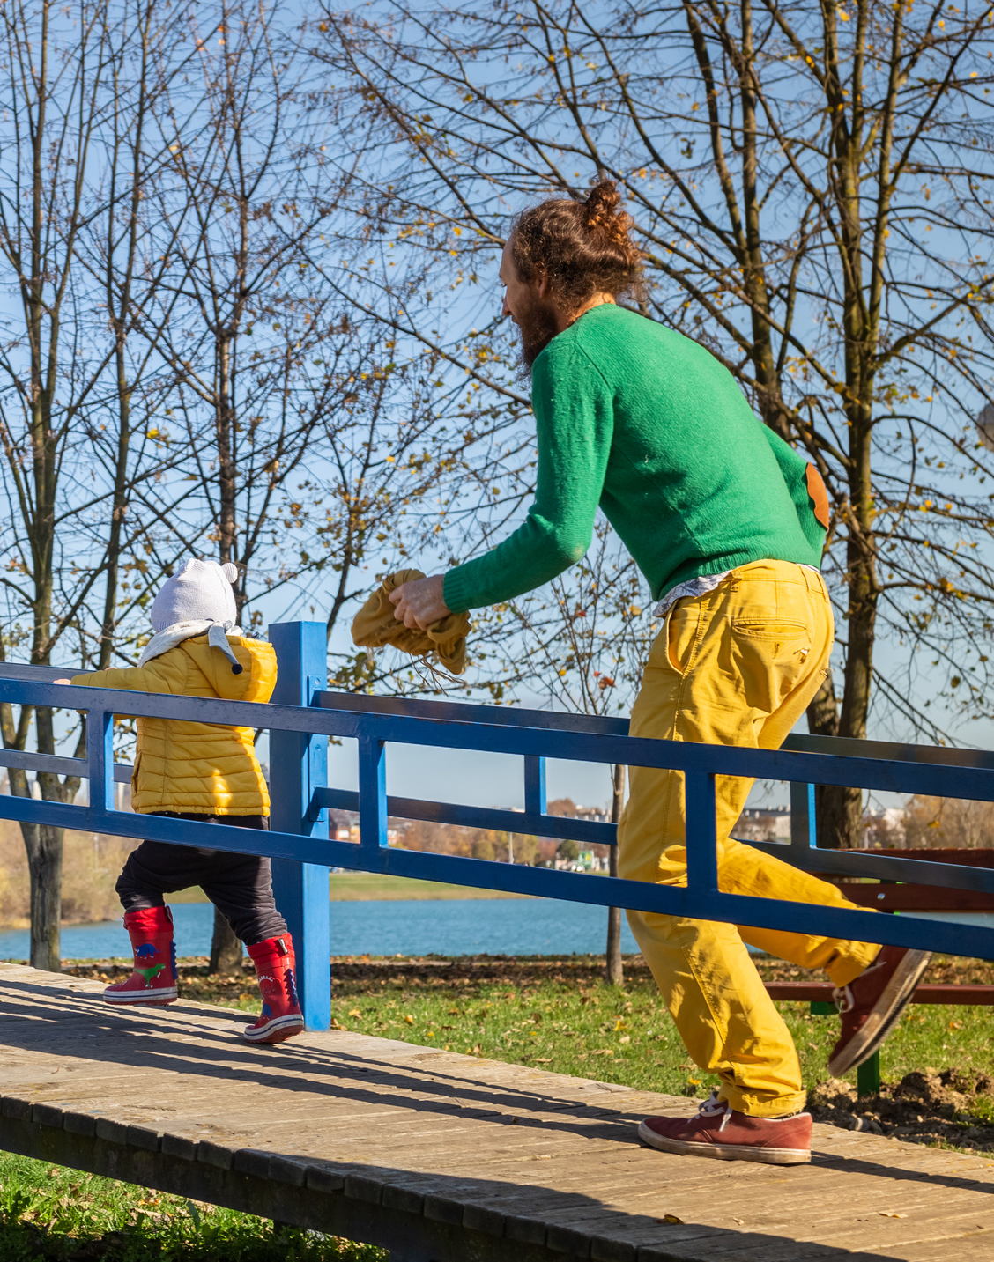
Avoidant Attachment
  Children fails to cry when parents were gone
  Children ignore the return of their parents
  Minimize proximity seeking with parents
  Response to parents appears unemotional
  Parents were emotionally unavailable, imperceptive, rejecting and unresponsive
    Such parents demonstrated low degrees of affect attunement

Slide 7
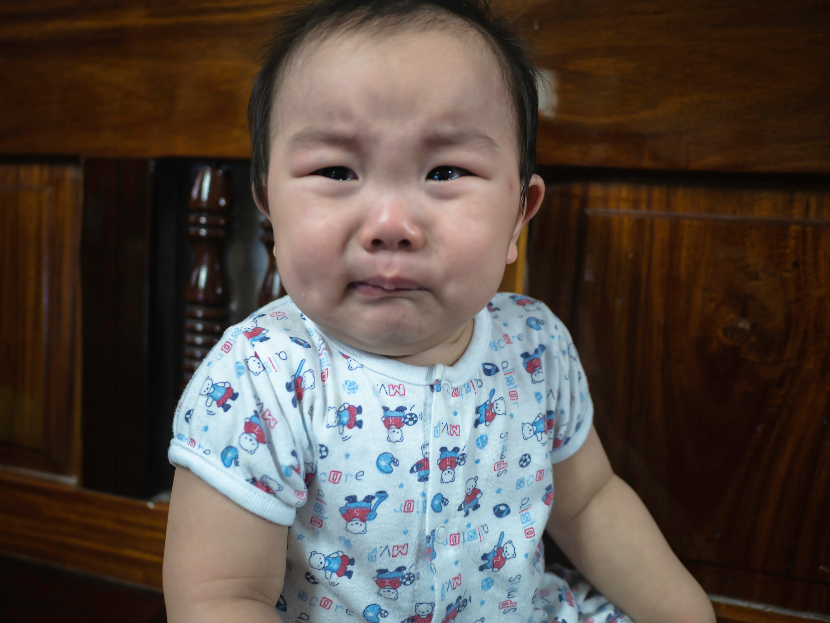
Ambivalent Attachment
  May be wary or distressed prior to separation, little exploration in the room
  Preoccupied with parents throughout procedure, may seem angry or passive
  Fails to settle and take comfort in parent during reunion
  Response to parents appears unemotional
  Parents were inconsistently available, perceptive and responsive

Slide 8
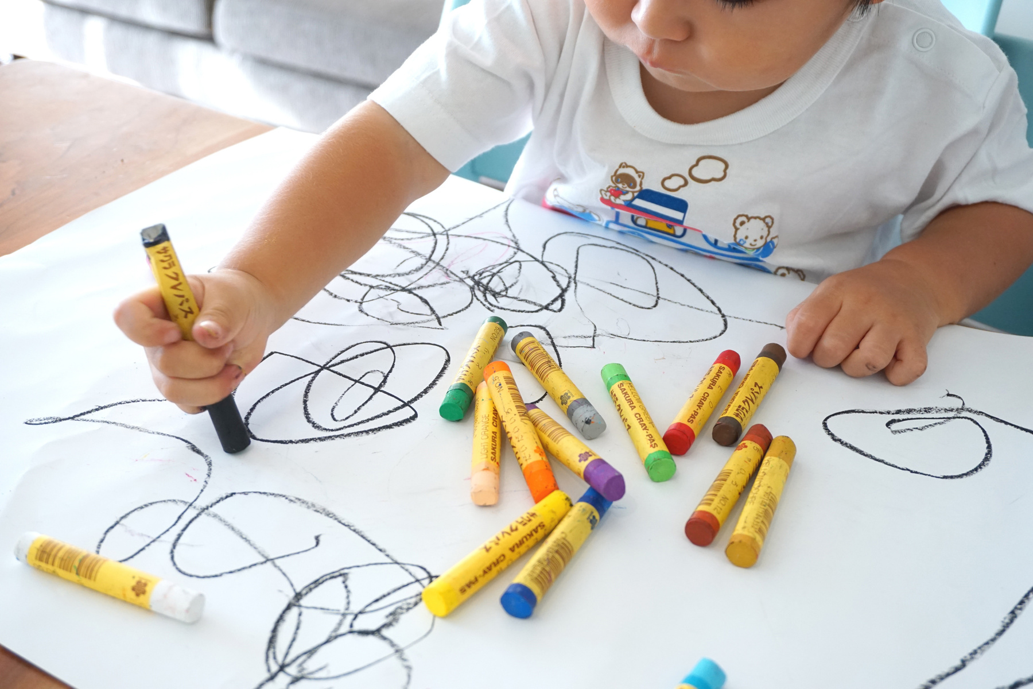
Disorganized/Disordered Attachment
  Children appears disorganized and disoriented during return of parents
    E.g. spinning in circles, approaching and then avoiding parents, freezing
  Parents who show frightened or disorientated communications during first year of life
  Child's sense of self can be described as fragmented
  Associated with serious family dysfunction

Slide 9





How does attachment affects children?
Secure
Avoidant
  Most likely to have the best outcome; better adjusted and more socially skilled
  Controlling, aggressive, and disliked by peers
Ambivalent
Disorganize
  Social competence may be compromised
  Predisposition for social anxiety
  Most difficulty in life
  Highest likelihood of having clinical difficulties

Slide 10
THANK YOU!
THOUGHTS?

