Slide 1
GRIT Programme

Slide 2
What is the GRIT Programme?
The GRIT program for teens stands for GROWTH, RESILIENCE, INTEGRITY and TENACITY. It is a program that equips teenagers with essential life skills to help them navigate through tough challenges and thrive in various situations they may experience in their everyday lives.

Slide 3
Our Objective
The objective of the GRIT Programme is to equip participants with the strategies and mindset necessary in order to thrive and be foster resilience in the face of adversities in their day to day challenges.
Mission Statement
To instil and cultivate a growth-seeking mindset, fostering determination, grit and resilience needed to overcome challenges in order to achieve long term successes.

Slide 4
Importance of the GRIT programme
Essential for personal and professional development
Improved performance and productivity in any given situation
Increased sense of self and fulfilment in personal and professional life
Increased adaptability and resilience

Slide 5
Framework
A 3 month long program
12 sessions
2 hours per week
The program will typically be that of a coaching workshop along with various activities and discussions pertaining to the topic assigned. The platform will provide the opportunity for learning and developing key skills, goal setting, proper time management, good decision making and a better sense of self.

Slide 6
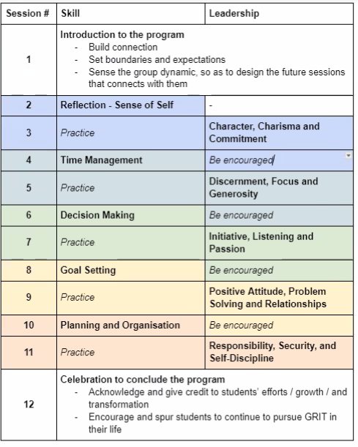
Structure of program

Slide 7
What are we targeting?
Teens who are ‘at risk’ at school and who needs help with developing resilience, perseverance and a growth mindset to overcome challenges and achieve long term goals.

Slide 8
Impact we have made with other clients

